Slide 1

VITA App
Site Coordinators Reference

Slide 2
Why an App?
Improve client experience
Reduced wait times
Provide feedback
Improve volunteer experience
Go where they are most needed
Provide suggestions
How:
Focus volunteers on sites that need and can use help
Client: Visibility to sites and support options (MFT, Express, etc.)

Slide 3
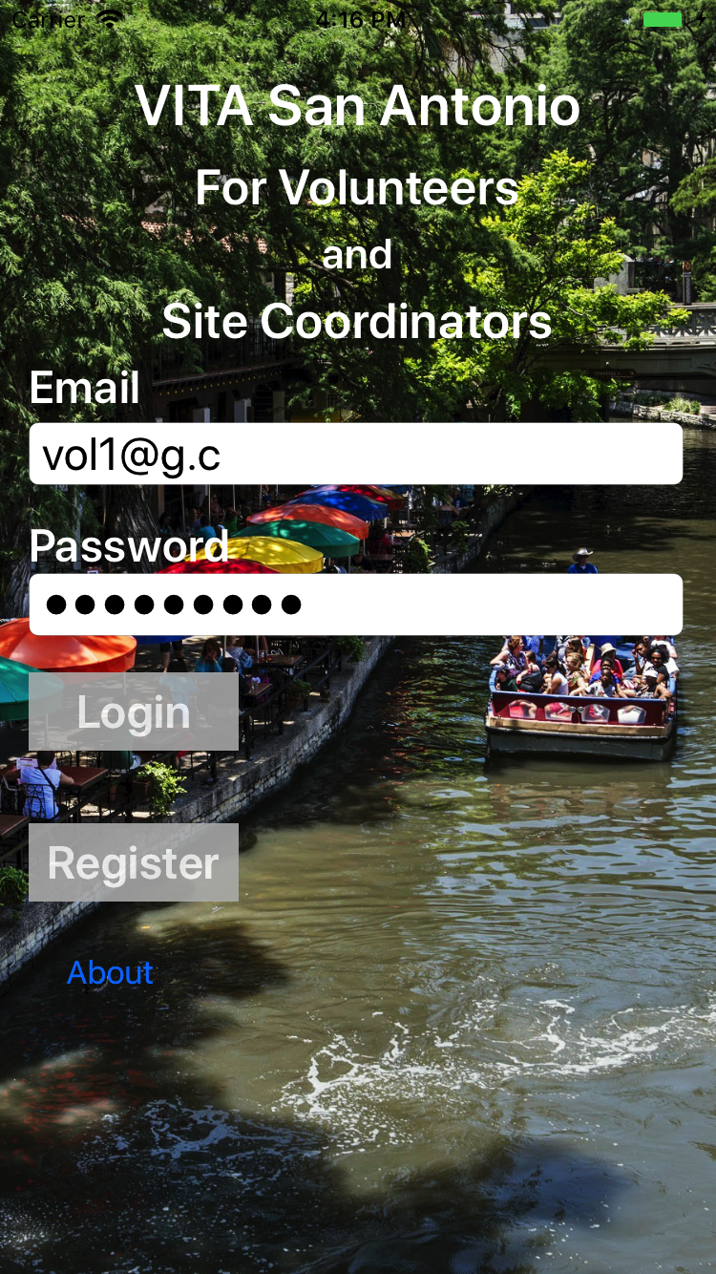
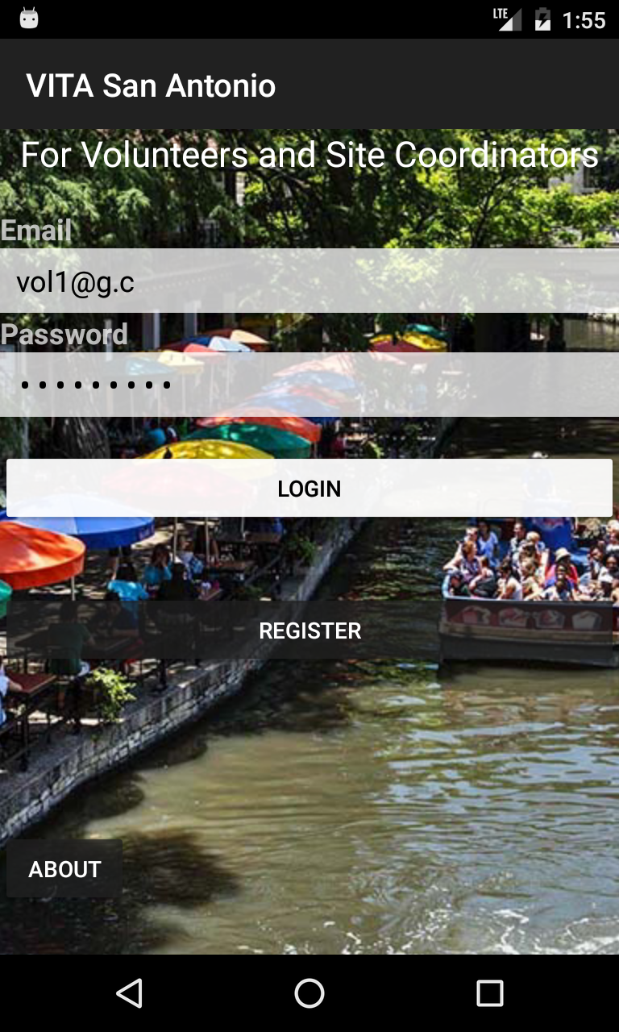
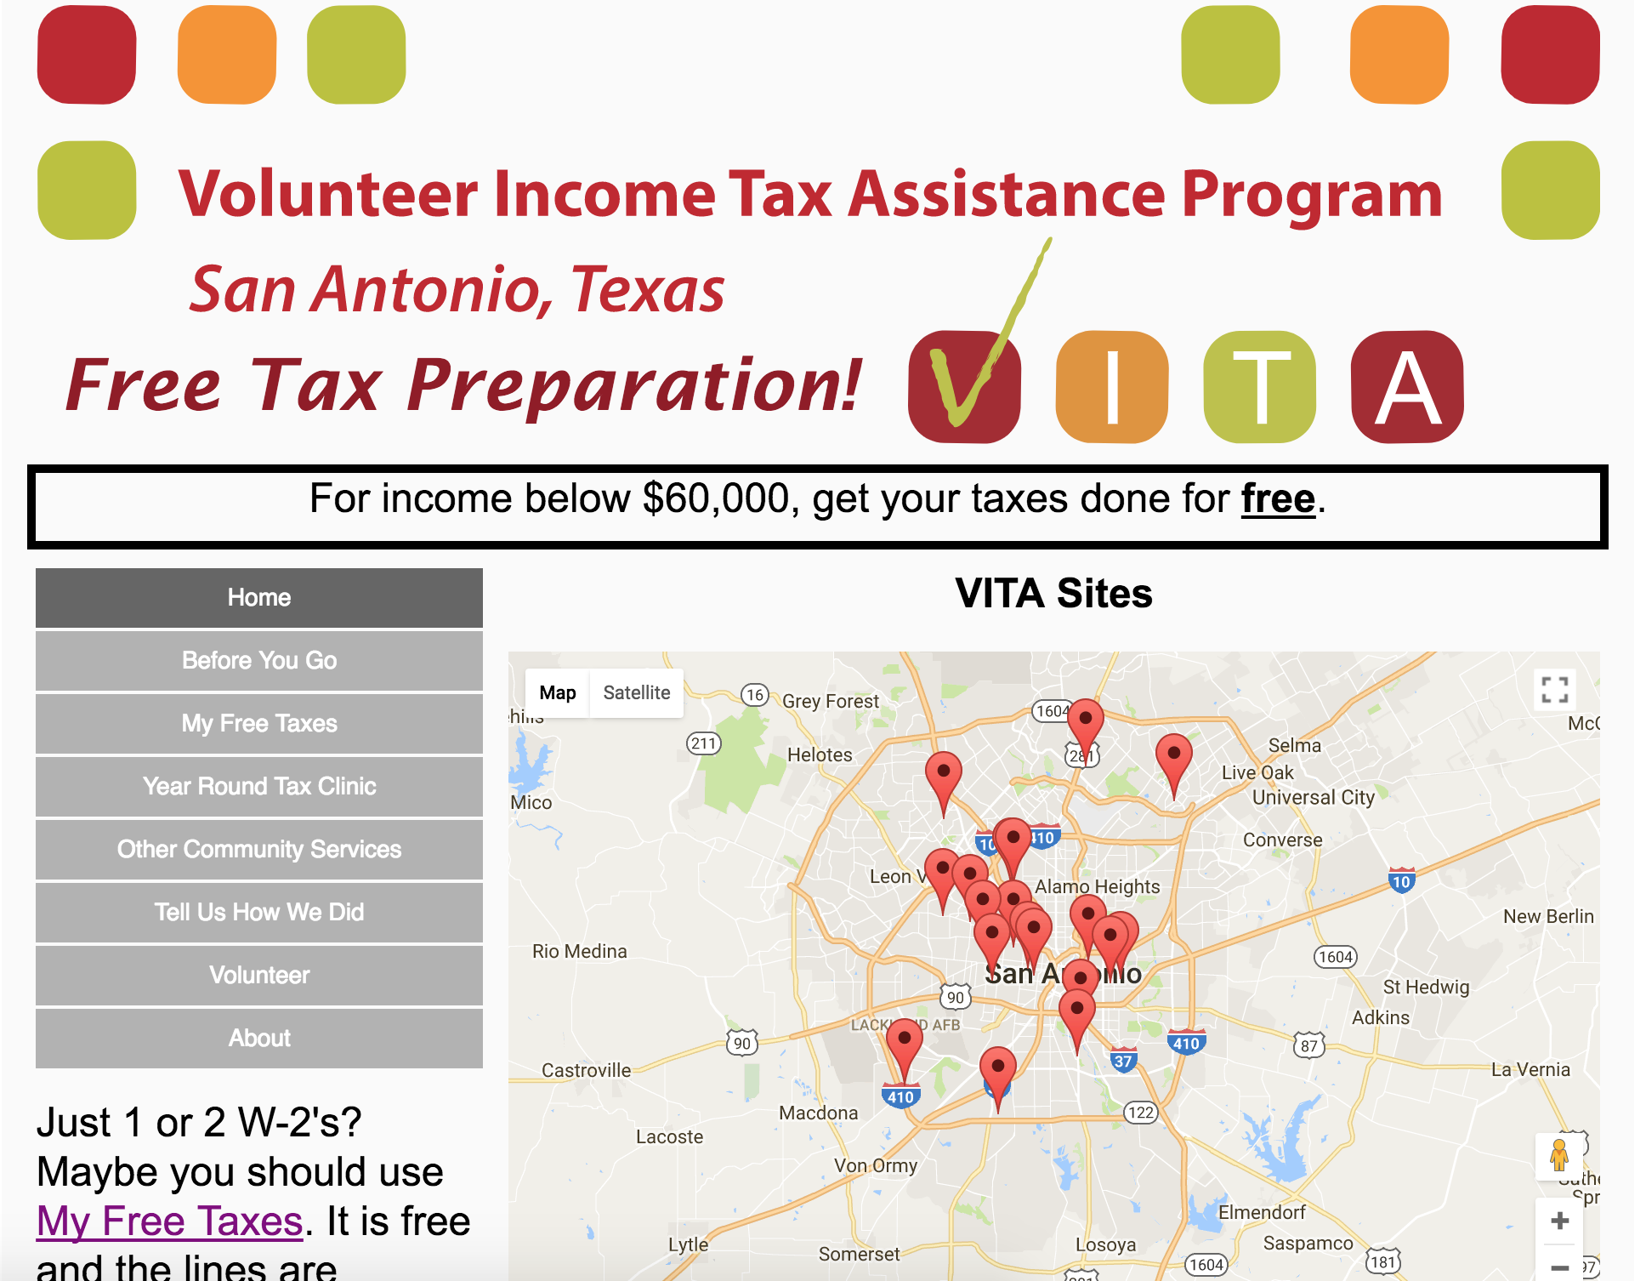
VITA App and Website
Volunteers & Site Coordinators
VITA Clients
(English and Spanish)
iOS Devices
Android Devices
Browser and mobile devices

Slide 4
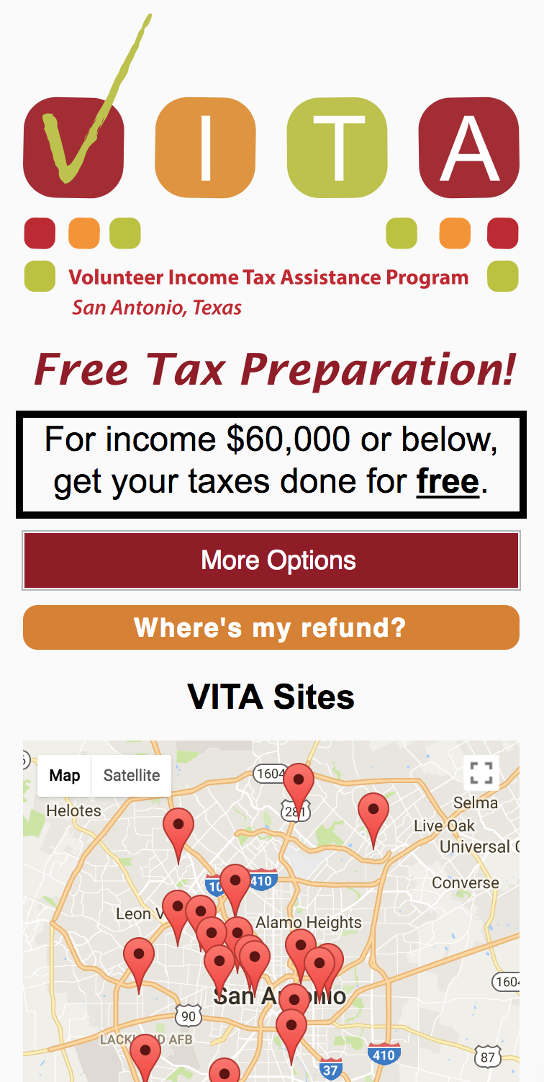
vitasa.org - Clients
Try it out: vitasa.org
Map of sites and guidance on what to bring
Info on VITA
List of VITA sites, address, and services
My Free Taxes: map and instructions
Year Around Tax Clinic: locations and services
Community services: list and services
Client feedback
Contact Us: Alejandra and Sheila
Volunteers: why and how to volunteer
(Spanish and English)

Slide 5
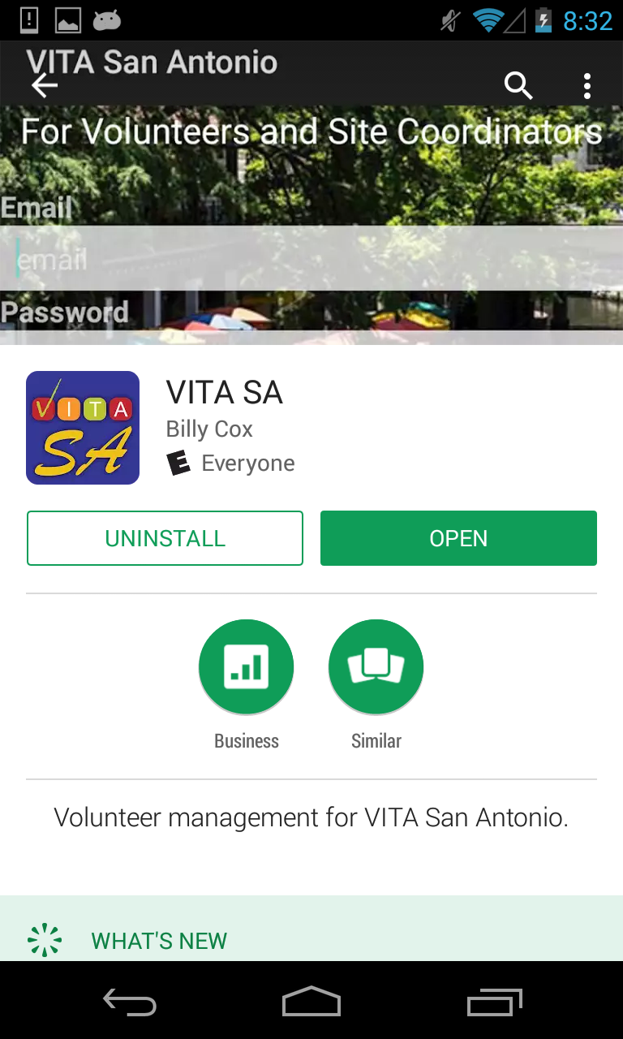

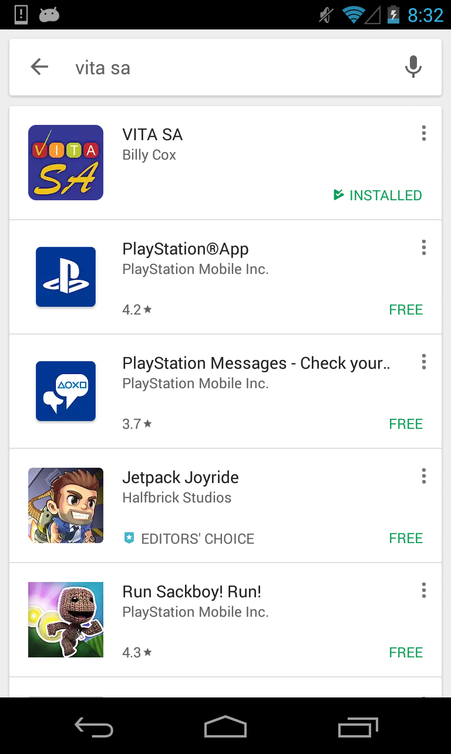
Installation - Google
Open Google Play Store
Search for “vita sa”
Select VITA SA
Then “Install”

Slide 6
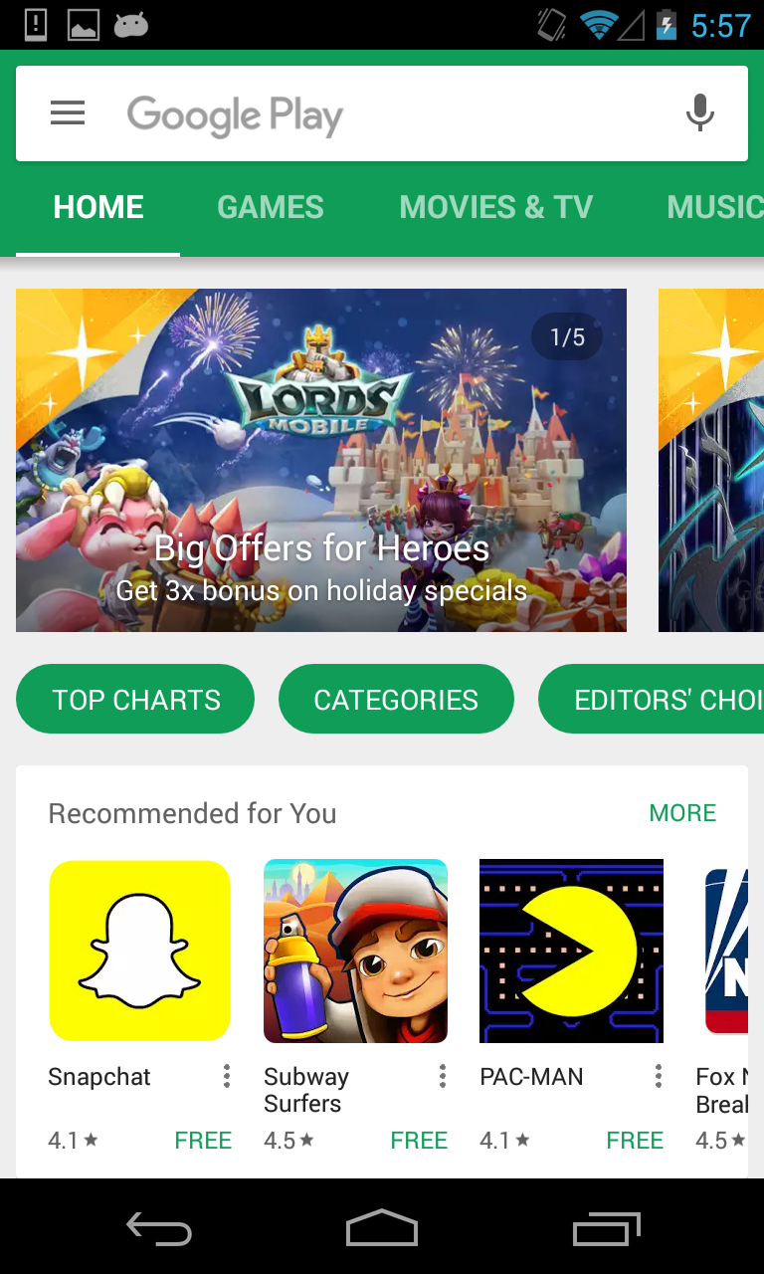
Update - Google
Open Google Play Store
Open Settings

Slide 7
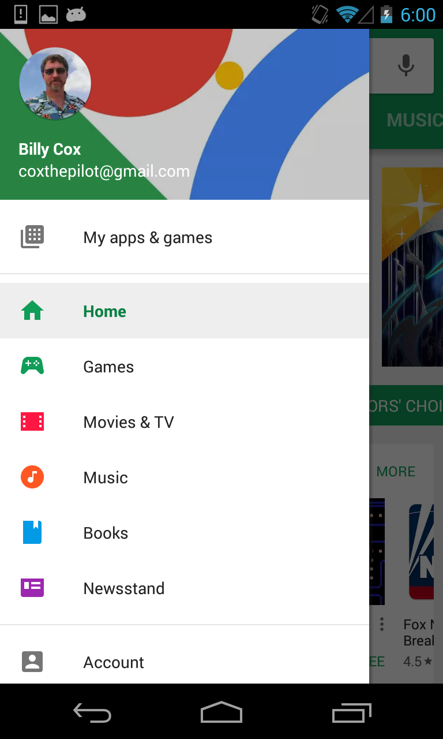
Update - Google
In Google Play -> Settings
Select My apps and games

Slide 8
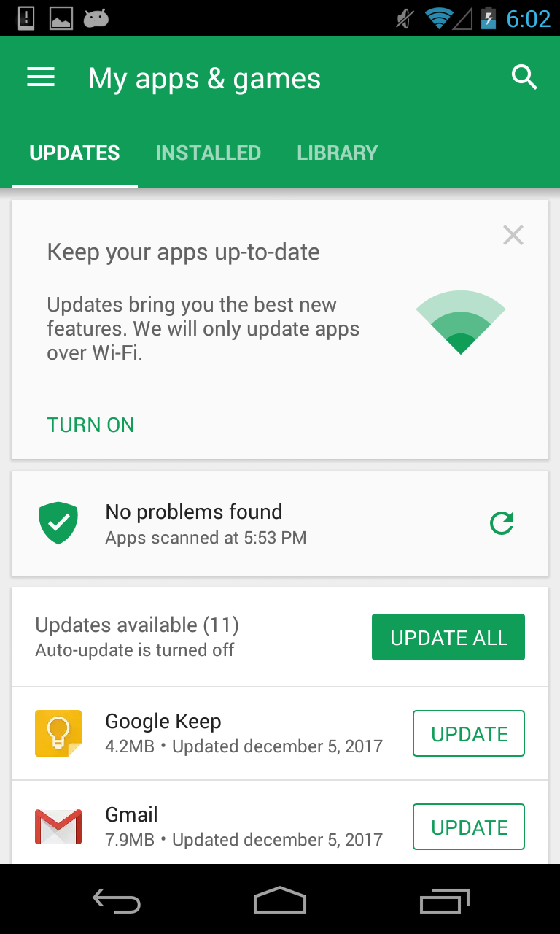
Update - Google
VITA SA app will appear in this list if there is an update waiting to be installed

Slide 9

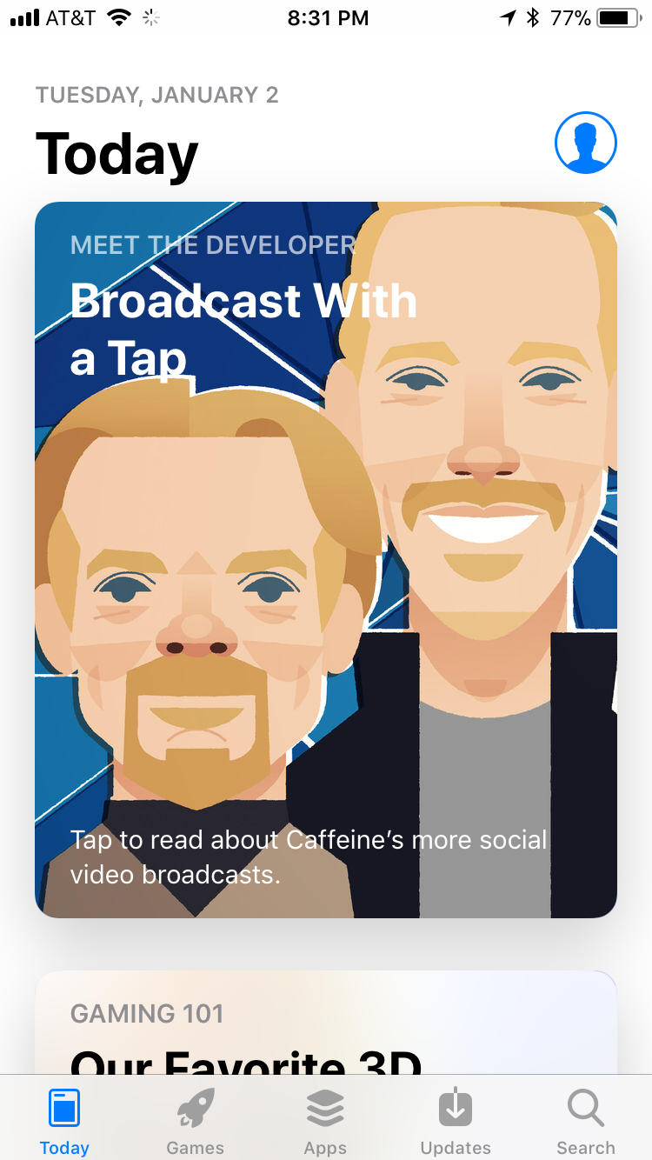
Installation - Apple
Open Apple App Store
Open Search

Slide 10
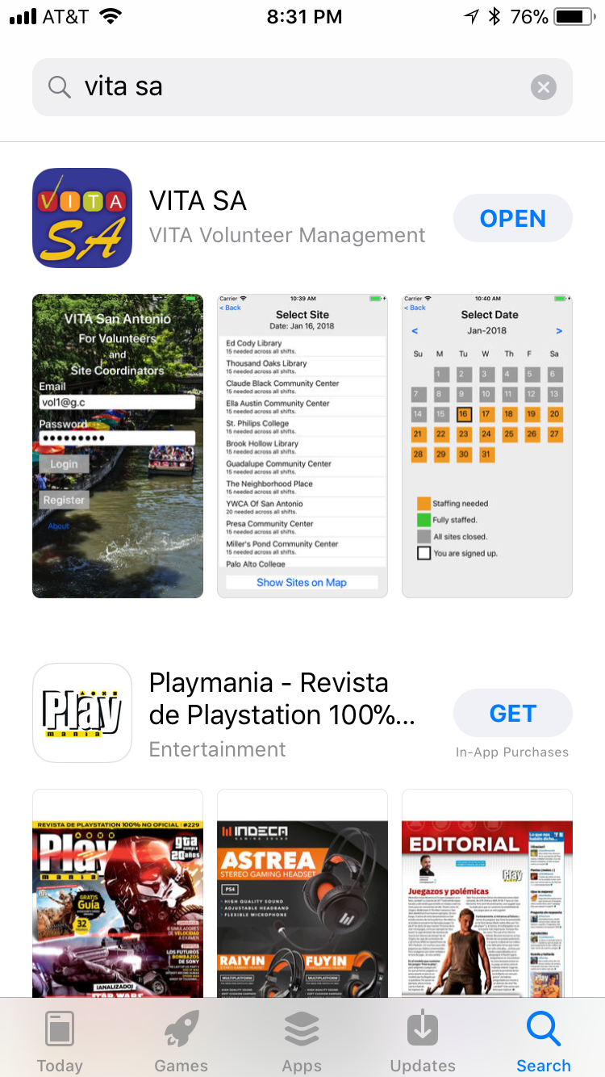
Installation - Apple
Search for “vita sa”
“VITA Volunteer Management”
Touch “Get” (it’s free)

Slide 11
Update- Apple
Open App Store
Touch Updates
VITA SA will appear if an update is available

Slide 12
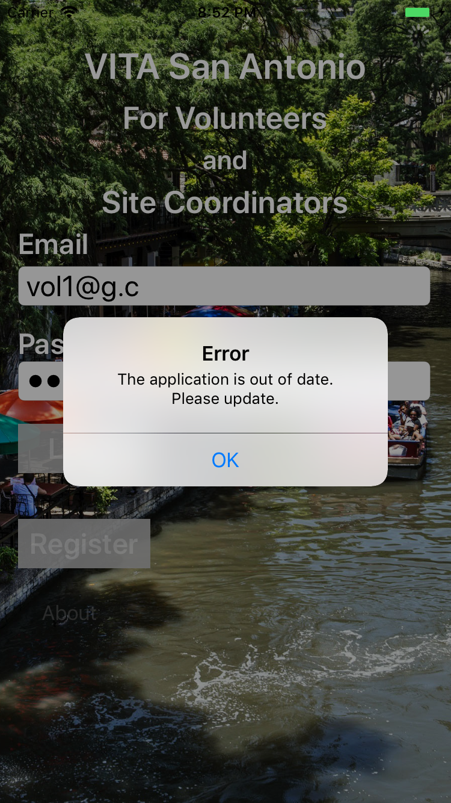
Need for App Update
You will need to update your app to proceed if you see: “The application of out of date. Please update.”

Slide 13
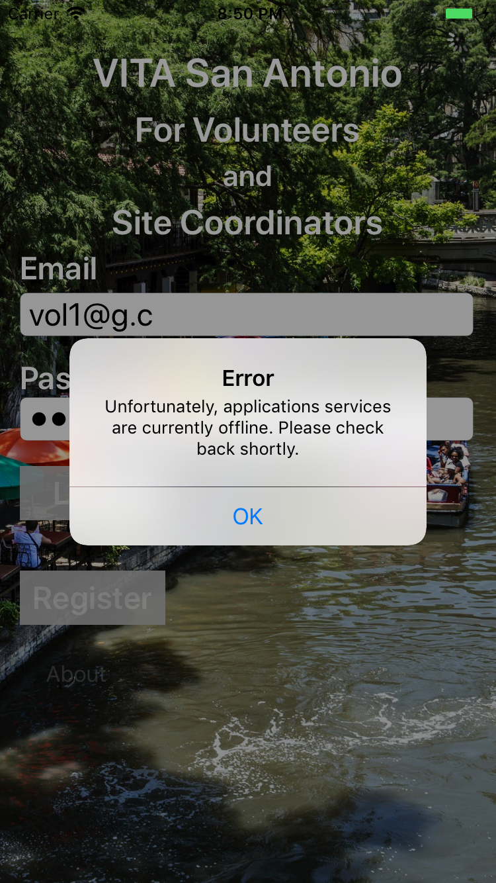
App is temporarily offline
If the app is down for maintenance, you will see this message.
Check back in a few minutes

Slide 14
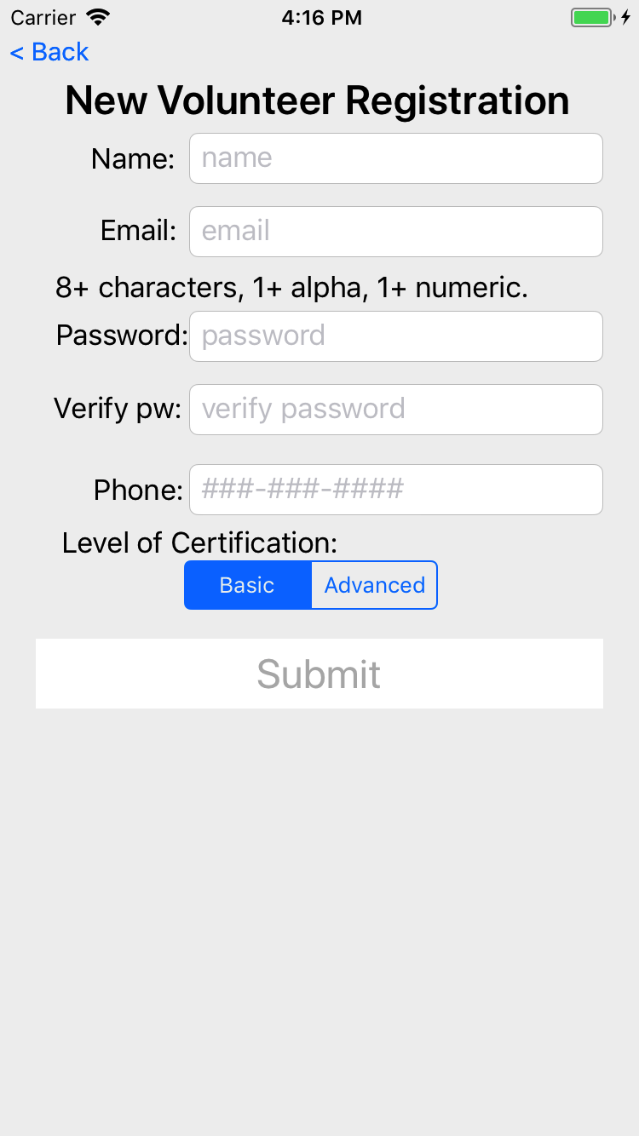
Register
All Volunteers and Site Coordinators must register
Register
Enter name, email, password, phone, and certification
Make sure you enter the exact same password twice
Press Submit

Slide 15
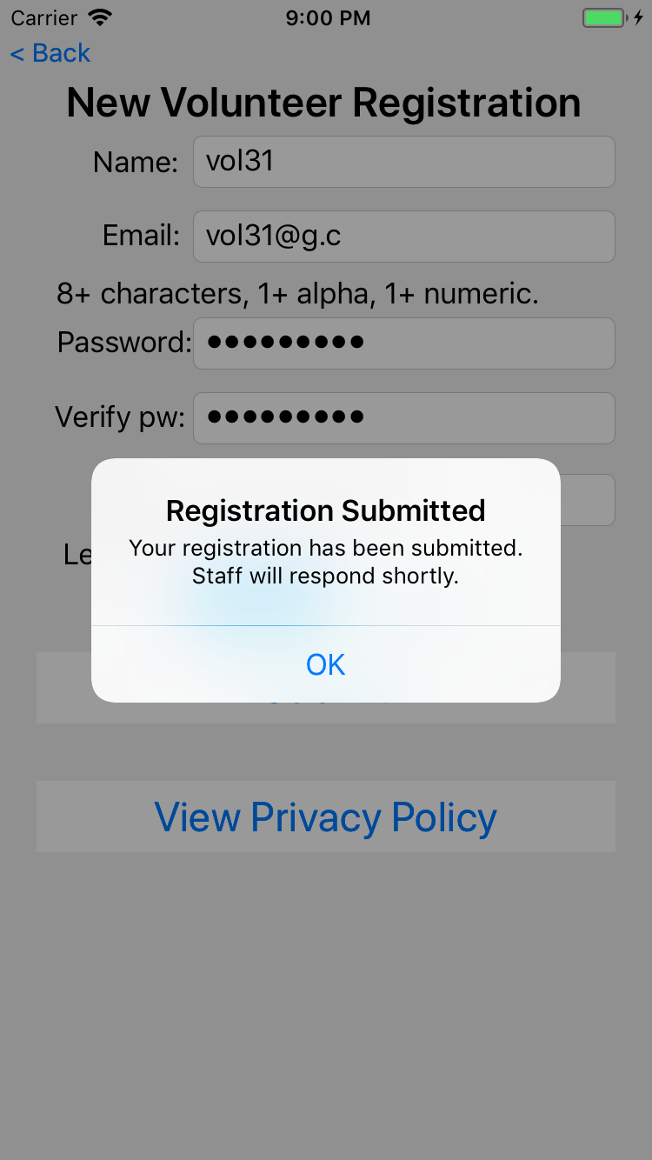
Register
On successful registration you see this message.
The back office staff will then check to records to ensure you are ready for approval and enable you to access the system

Slide 16
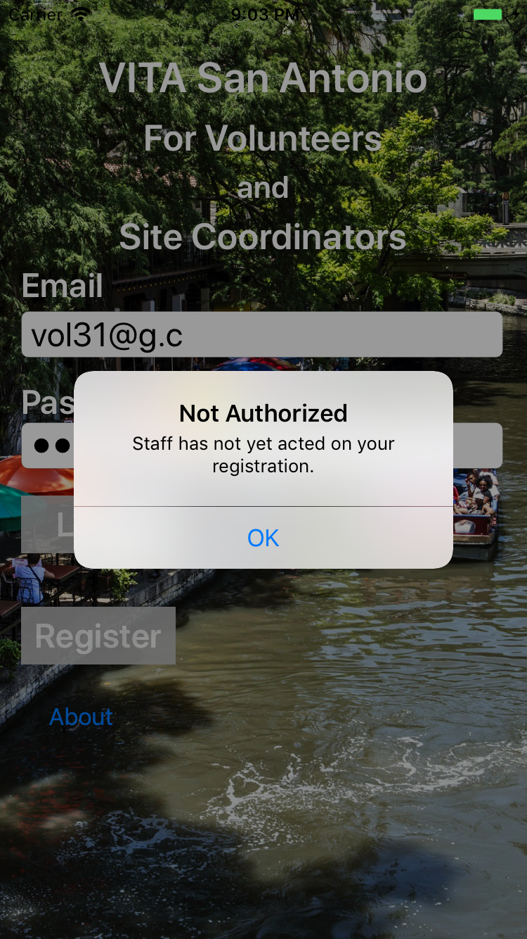
Registration
If you attempt to login before back office staff have approved your registration, you will see this message.

Slide 17
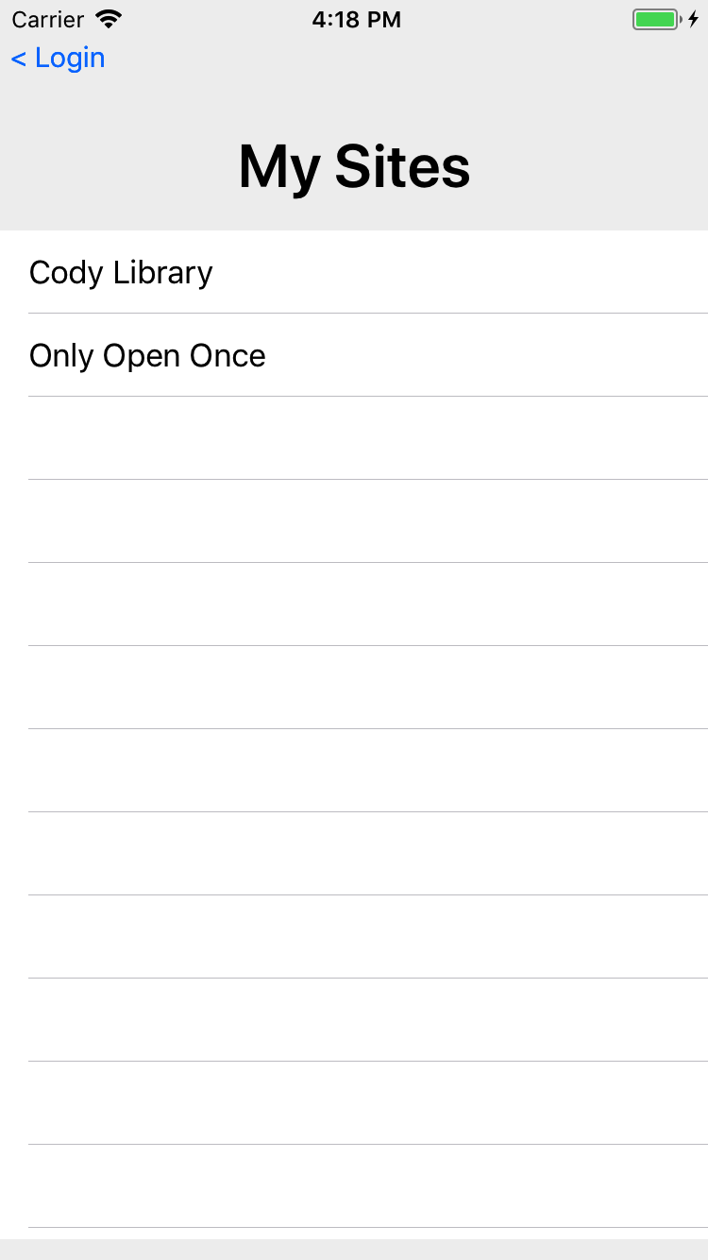
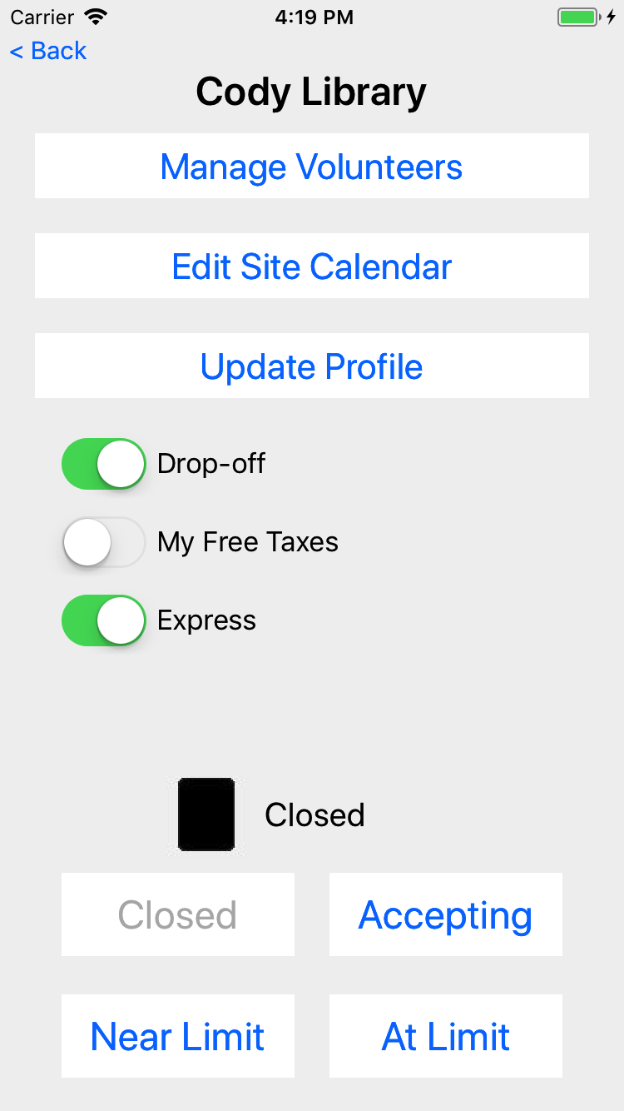
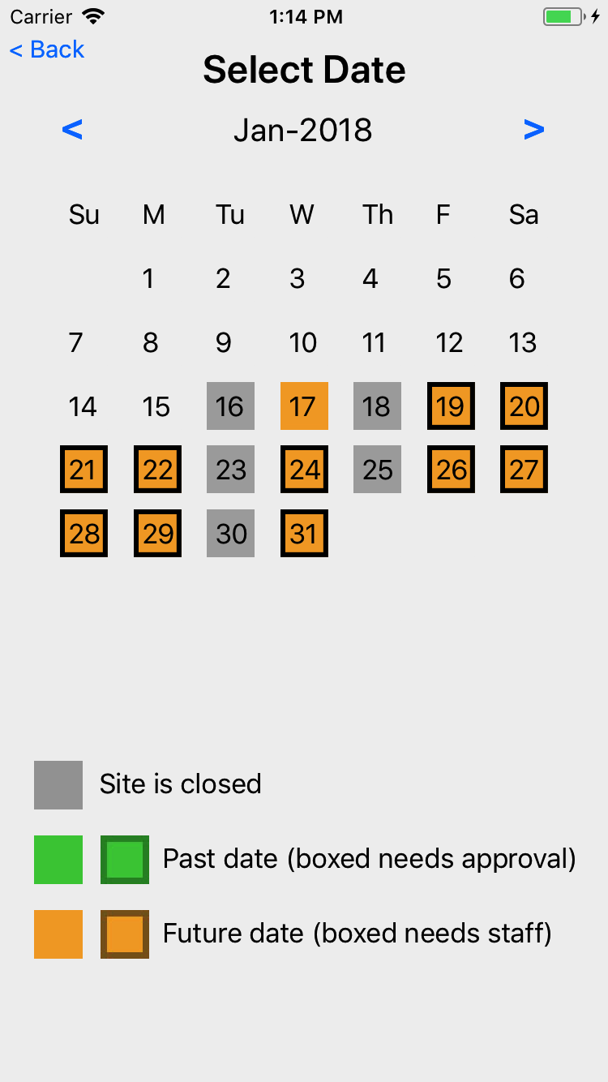
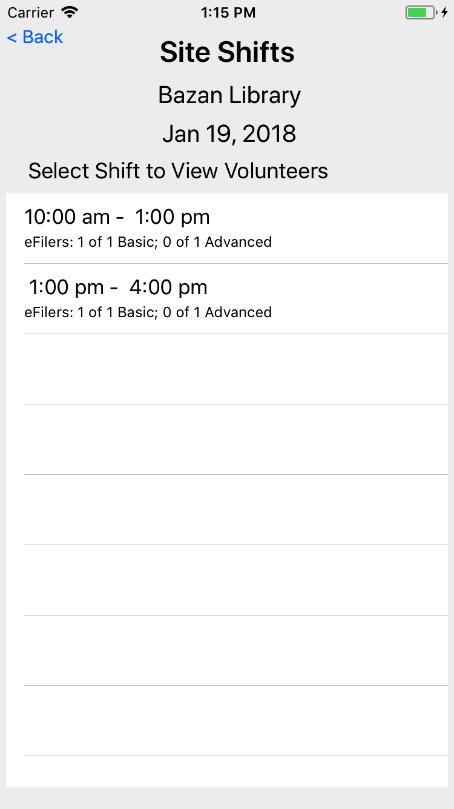
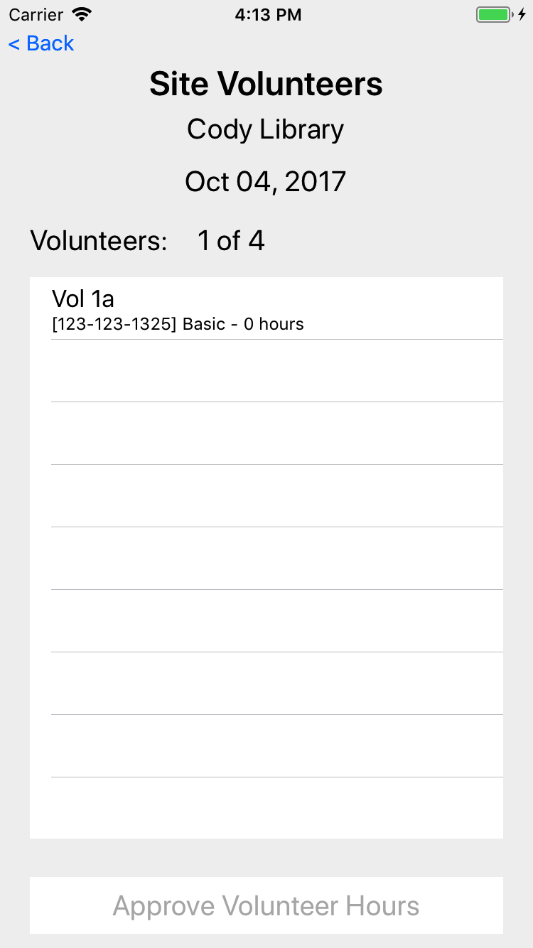
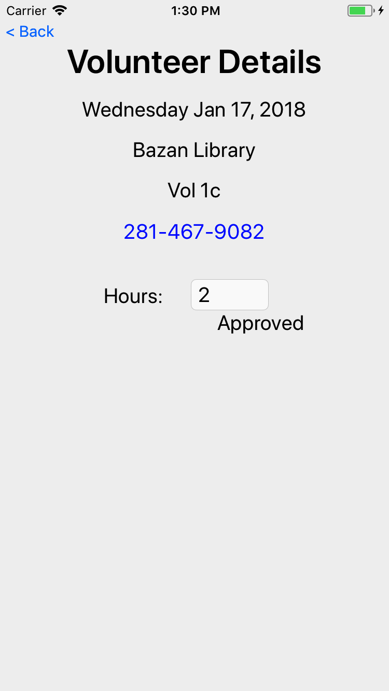
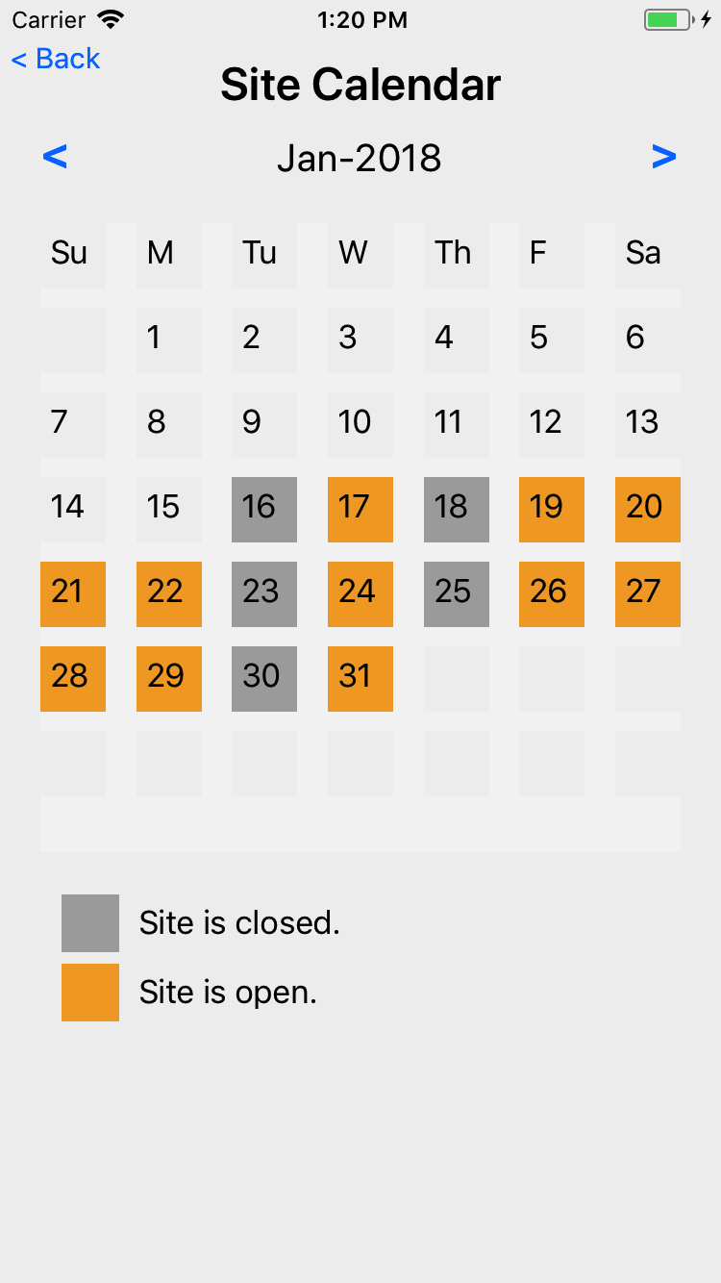
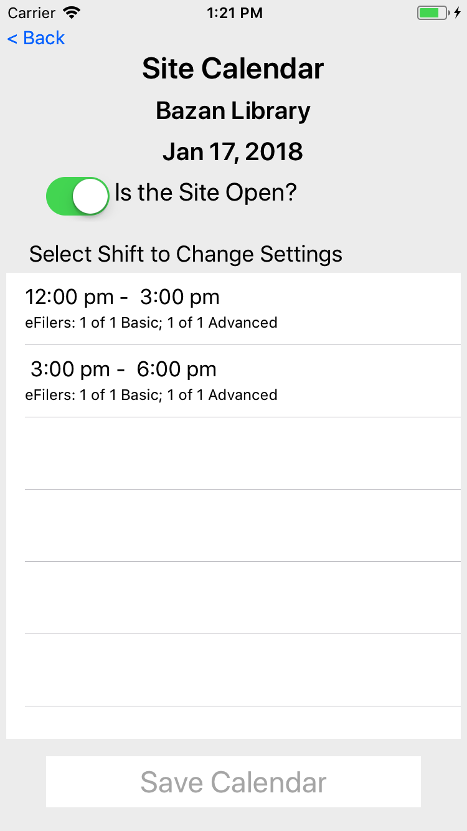
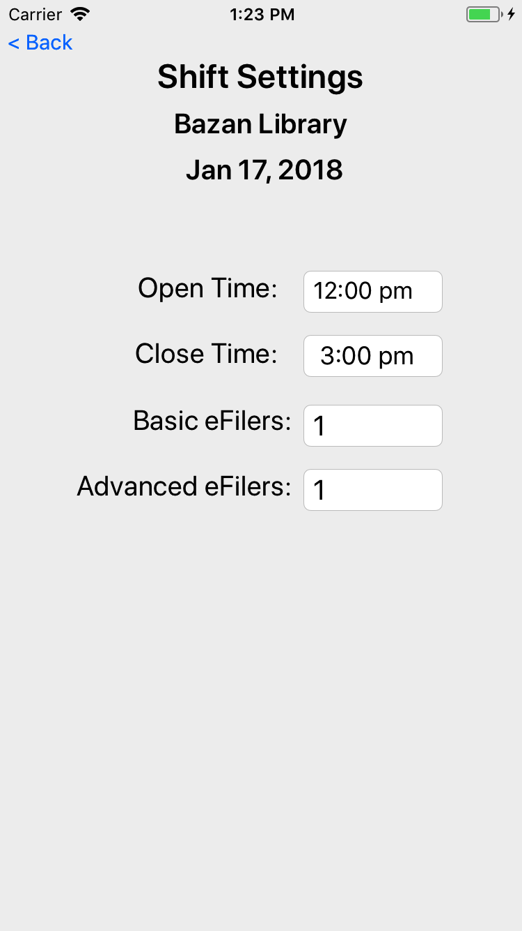
VITA App – Site Coordinators
Select Site
Manage
Dates
Shifts
Volunteers
Receive notifications from management office.
Site Calendar
Shifts
Shift Details

Slide 18
Site Coordinator Actions
The app supports the following:
Update site services
Update site calendar including open/closed, shift hours, and number of volunteers needed
Approve eFiler hours
Only back office staff can do the following:
Cause a site to be open when it initially configured to be closed (with zero shifts)
Add or remove shifts
Make bulk changes to number of required eFilers across many shifts and dates

Slide 19
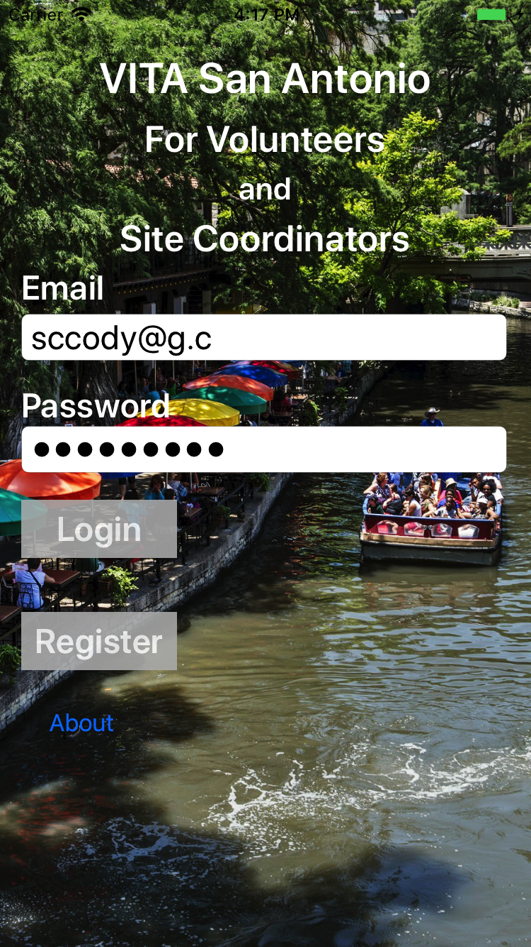
Login
To access any capabilities in the app, you must first login

Slide 20
Login
If you are a Site Coordinator or Backup Site Coordinator for 2 or more sites, you will see the following screen.
Select the site to manage
If you are Site Coordinator for only 1 site, you will not see this screen.

Slide 21
Update Site Features
Primary screen for managing a site
Adjust features as needed
Client status not used
Site features
Client Site Status (not used)

Slide 22
Update Site Calendar

Slide 23
Update Site Calendar
Touch day of week to change site calendar

Slide 24
Update Site Calendar
List of shifts on this date
If the site was initially configured to be closed, there will be no shifts shown.
Contact back office if you need to be open on a date for which it was originally closed
Use “Save Calendar” after making adjustments to open/close or shifts
The number of shifts can only be changed by the back office staff
Touch a shift to make changes

Slide 25
Update Site Calendar
Set open/close time for this shift on this date and this site
Only one shift is affected
Set number of eFilers for Basic and Advanced
Use < Back to go to the previous screen when done.
Be sure to save your changes
5
5

Slide 26
View Volunteers

Slide 27
View Volunteers
Dates in Orange are dates in the future
Grey means the site is closed
Orange means the site is open and is fully staffed
Boxed Orange means the site is open and one or more shifts needs staffing
Touch a date to view the shifts on that date

Slide 28
View Shifts
List of shifts
Quick summary of the number of volunteers for each shift currently signed up
Touch a shift to see who has signed up for that shift

Slide 29
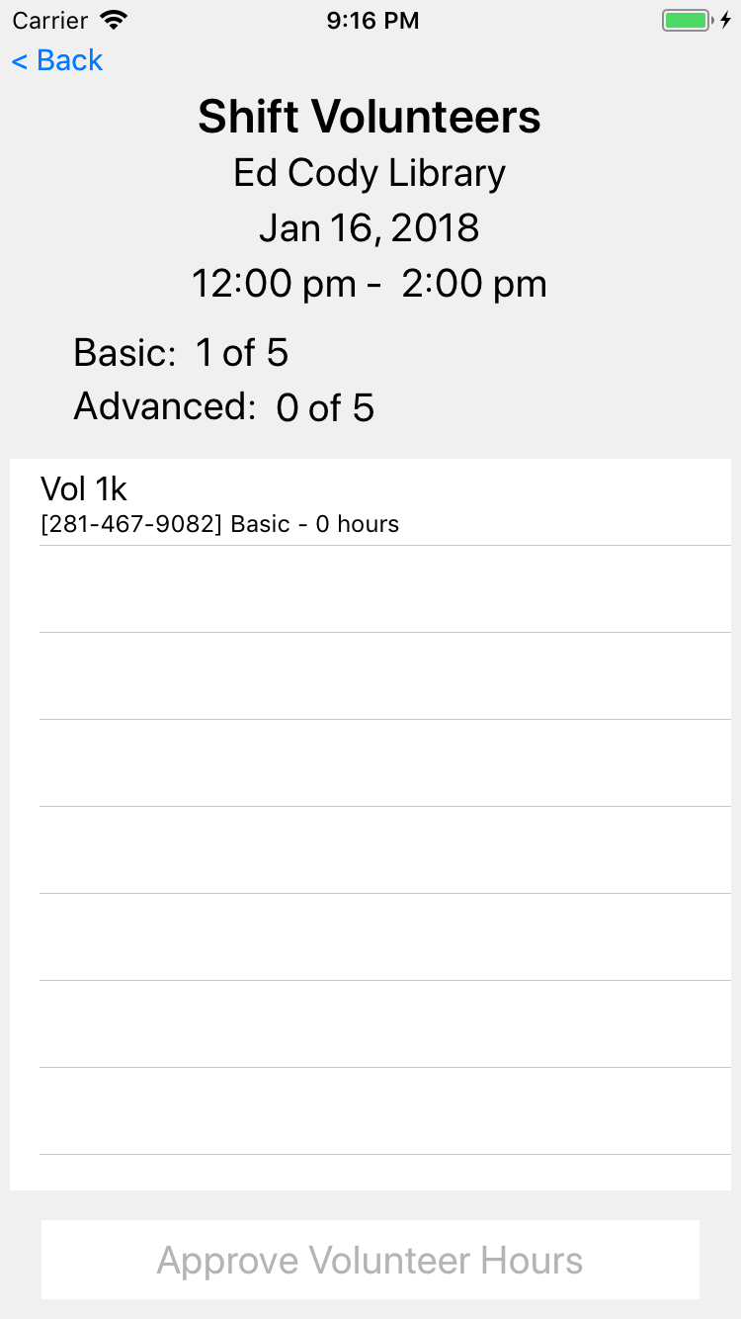
View Volunteers
List of volunteers signed up to be at a site on a date
Phone and certification provided
Touch volunteer to view/change hours

Slide 30
View Volunteers
Adjust hours worked as needed
Volunteer can change hours until end of date
Touch phone number to call the volunteer

Slide 31
Approve Volunteers Hours

Slide 32
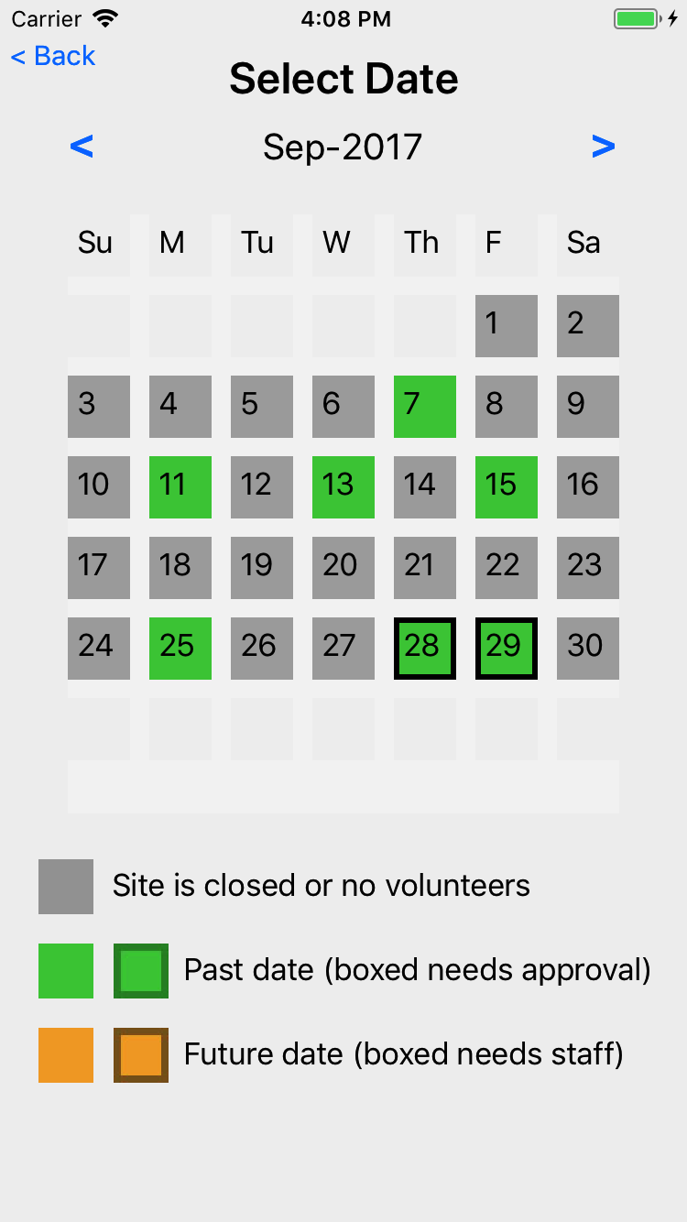
Approve Volunteers Hours
Dates in Green are dates in the past
Past dates are used to manage volunteer hours

Slide 33
Approve Volunteers Hours
Touch volunteer to view/change hours
Be sure to “Approve Volunteer Hours”
This will mark the hours for all volunteers are approved

Slide 34
Approve Volunteers Hours
Adjust hours worked as needed

Slide 35
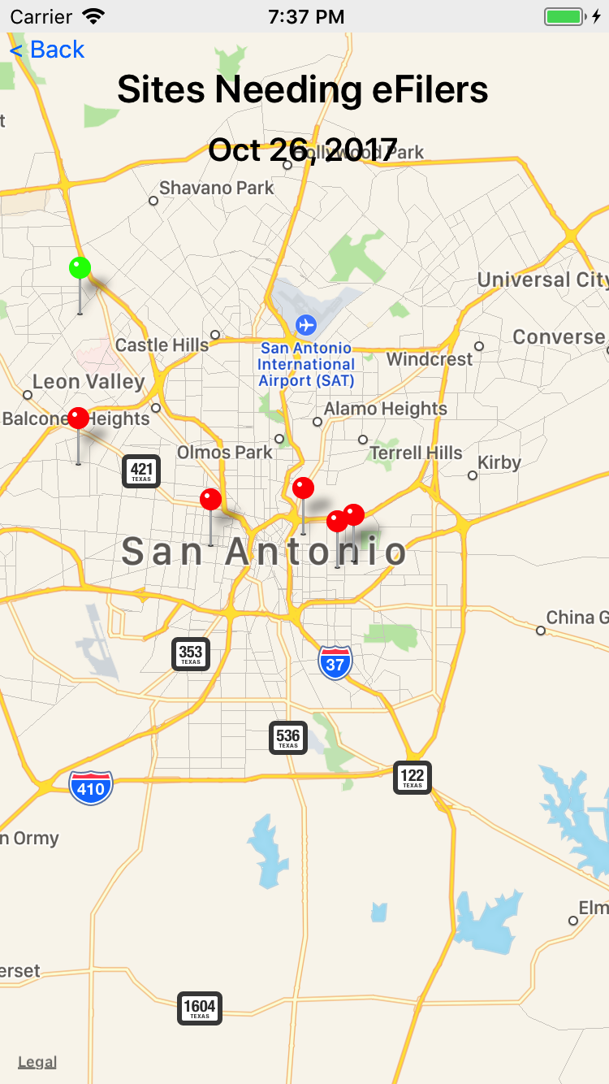
VITA SA App
Optimize the customer experience by fully utilizing staff, sites, and volunteers.
Encourage volunteers to go to the sites that need help.
(and away from sites that don’t)
Encourage clients to use the web and provide feedback.

